Slide 1
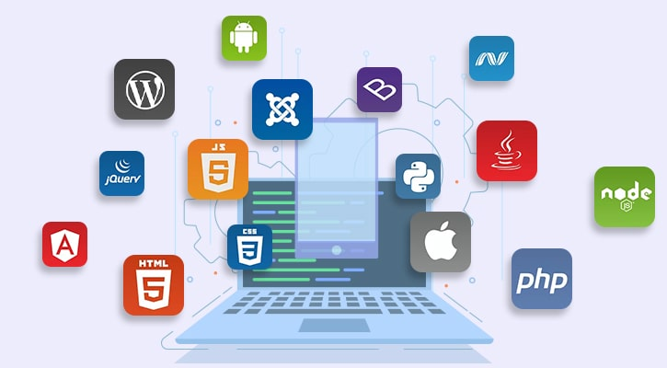

Slide 2
Principles Of Software Development
The development process is different in each company
But there is always a need to:
Understand business problem
Document non-technical business solution
Convert solution to technical architecture
Convert architecture to code
Manage developers
Test code
Deploy code
Of course, in some companies these responsibilities are mixed

Slide 3
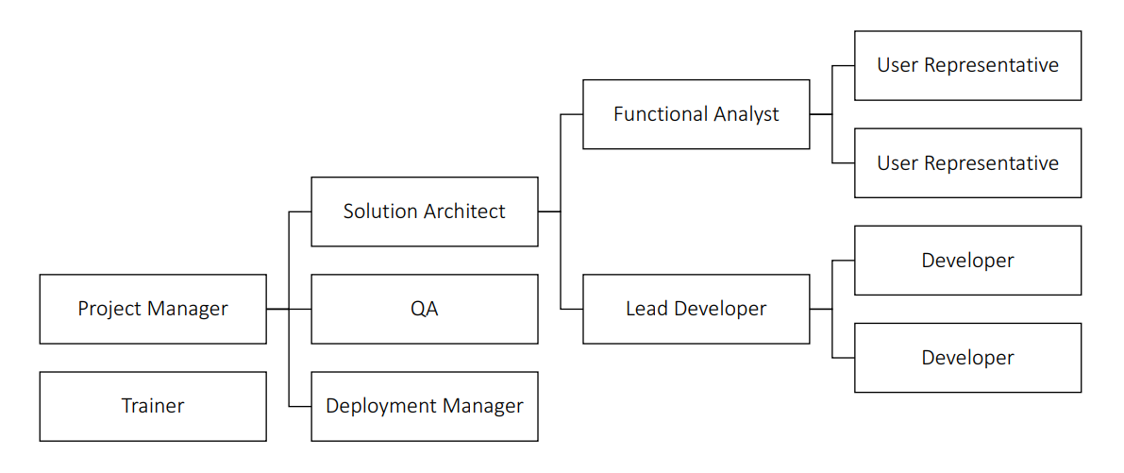
main Roles In Software Development

Slide 4
Required skills by everybody in the team
Understanding the Business
The more business understanding you have, the more useful you will be
Cross-Domain Understanding
You know bits of the other roles in the team as well
Multiple Perspectives
You need to see the problem from everyone's point of view
People Skills
Just to make sure communication goes smoothly
Lifelong Learning
IT is moving super fast; you need to stay relevant

Slide 5
Responsibilities Of The Functional Analyst
A product/project owner
Responsible for functionality
Captures, consolidates, and communicates information
Constantly asks questions:
What do you mean?
How does this fit in with…?
Etc.
Identifies and resolves conflicts
Produces requirements specification

Slide 6
Skills Of The Functional Analyst
Precise communicators
Great attention to detail
Adept at dealing with differing opinions and conflicts
Know when detail is necessary and when not
Great relationship skills
Very good listener
Can create clear and precise documents
Skilled in using Office tools

Slide 7
If you want to be Functional Analyst
Pros:
Key role
Lots of interactions
Cons:
Must work with bad user representatives
Can expect conflict
Will receive blame if functionality is missing

Slide 8
Responsibilities Of The Lead Developer
Leads and mentors developers
Assigns tasks to developers
Based on their skill level
Details and partitions work
Ensures that all developers are successful
It is not always an official role
Usually, it is the person who helps everyone else

Slide 9
Skills Of The Lead Developer
Awesome programming skills
Willing to mentor and be value-driven
Grows out of the Developer role
Requires great relationship with Architect
Wide knowledge of libraries/tools/techniques
Adept at creating technical specifications
Adept at build & configuration management
Adept at debugging, post-mortem log inspection, etc.
Can create own tools if needed

Slide 10
If you want to be Lead Developer
Pros:
Lead-in to a Solution Architect
Involves coding (optional, not necessary, but suggested)
Can pick & choose cool tasks
Cons:
Can get squeezed between the Solution Architect and the Developers
Lifelong learning required
Turns into a Developer if the Project Management is weak
Loses motivation
Team might be too small
Vulnerable to offshoring

Slide 11
Responsibilities Of The Solution Architect
Massive responsibility
Functional understanding, technical knowledge and leadership skills
Responsible for the technology stack
Converts functional requirements to a technical architecture
Carefully balances patterns/requirements/elegance/concepts
Researches key technologies
Has deep understanding of design and architectural patterns
Motivates and guides development team
Ensures that the Lead Developer is successful

Slide 12
Skills Of The Solution Architect
Grows out of Lead Developer role
Requires great relationship with Lead Developer
Always maintains helicopter view
It is not bad to help with code, but there is another role for that
Deep understanding of design patterns
Fluent in UML or other design tools
Experience with tools & code generators

Slide 13
If you want to be Solution Architect
Pros:
High value position
Great salary
Visible role
Lots of interactions
Safe from outsourcing
Cons:
Difficult to stay up to date
Difficult to get right
Can receive bad requirements
First in line to receive blame

Slide 14
Types of architects in the IT world
Infrastructure Architects
Design the infrastructure
Servers, VMs, network, storage, etc.
Familiar with requirements
Promoted from Infrastructure Expert
Solution/Software/System Architect
Responsible for the architecture of the software
Enterprise Architect
Works with top level management - CEO, CIO
Streamlines the IT to support the business
No development-oriented tasks
Promoted from Senior Solution Architect / Project Manager

Slide 15
Ideal world vs real-life
We've looked at software development team roles in an ideal world
Real-life is not exactly like that
Missing roles
Individuals with conflicting roles
Disempowered roles
Other inconsistencies
The organization itself might lack the understanding of how developer teams are supposed to function

Slide 16
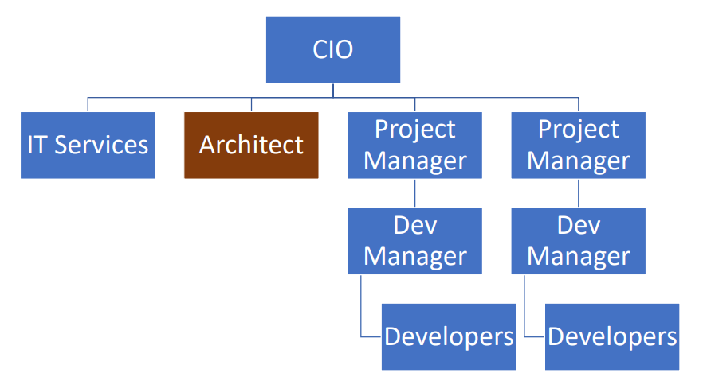
Organizational chart example 1

Slide 17


Slide 18
Software architecture
Structured solution to address all common software attributes:
Meets all the requirements
Performance optimized
Security in check
Manageability for developers
Scalability for business growth
Accessibility for easier user experience
Major requirements:
User requirements – the way end-users interact with the system
Business requirements – cheaper, faster, better than competitors
IT system requirements – infrastructure requirements

Slide 19
What composes an architecture?
The structural elements and interfaces composing the system
Objects – the low-level building blocks of the system
How these elements behave in collaboration
How communication is done in the architecture
The composition of elements into larger subsystems
How the elements are mapped to trees or graphs – the high-level data structure
The architectural style that guides this composition

Slide 20
What composes an architecture?
Additionally, our design should cover:
Functionality
Usability
Resilience
Performance
Economic and technology constraints
Trade-offs and aesthetic concerns
The goal is to:
Document high-level structure
Do not go into implementation details
Minimize complexity
Address all requirements
Be compatible with all use cases and scenarios

Slide 21
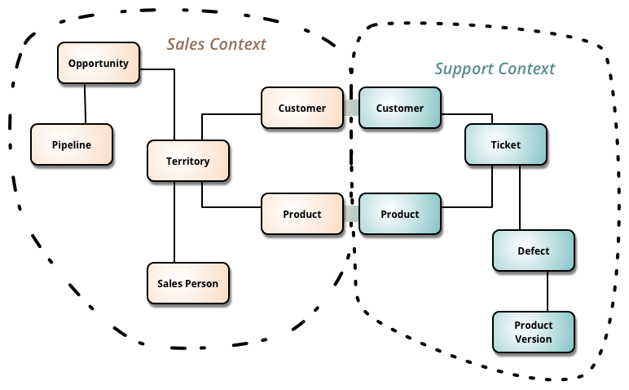
Our architecture needs
Separation of Concerns
Encapsulation
Dependency Inversion
Explicit Components
Single Responsibility
Don’t Repeat Yourself
Persistence & Infrastructure Ignorance
Presentation Ignorance
Bounded Contexts
Testability

Slide 22
Architecture abstraction
Layers:
System, Sub-systems, Layers, Components, Classes, Data and Methods
Bad Architecture:
Complex, Incoherent, Brittle, Untestable, Unmaintainable
Good Architecture:
Simple, Understandable, Flexible, Testable, Maintainable

Slide 23
Software Architecture Design Tips
Build to change instead of building to last
You are going to change your solution multiple times
Create around modularity and flexibility
Use models, but only to analyze and reduce risk
The models should be more abstract, otherwise you are taking the role of a developer
Use visualizations to communicate and collaborate
Your architecture is going to be a large diagram
Identify and research critical points of failure
Put in work in research in everything advanced
Security, scalability, resiliency

Slide 24
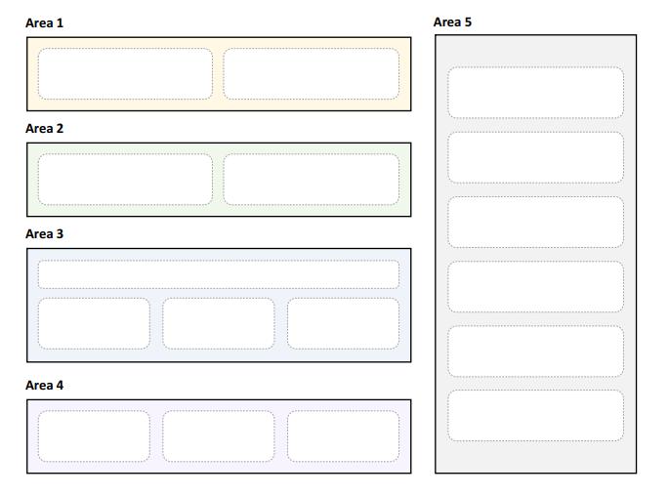
Areas Of Software Architectures
The goal of a software architect is to minimize complexity
This can be accomplished by separating the design into different areas of concern
Also known as modules (or components)

Slide 25
Key Principles Of Software Architectures
Separation of concerns
Each object and module should be in its own concern and context
Single responsibility principle
Elements in our design must have a single purpose
Principle of least knowledge
Components do not know about the internals of other components
Done through interfaces
Don’t repeat yourself
Don't have multiple components with the same purpose
Minimize upfront design
Try to design the minimum architecture so that developers can work
You will polish the next sections later

Slide 26
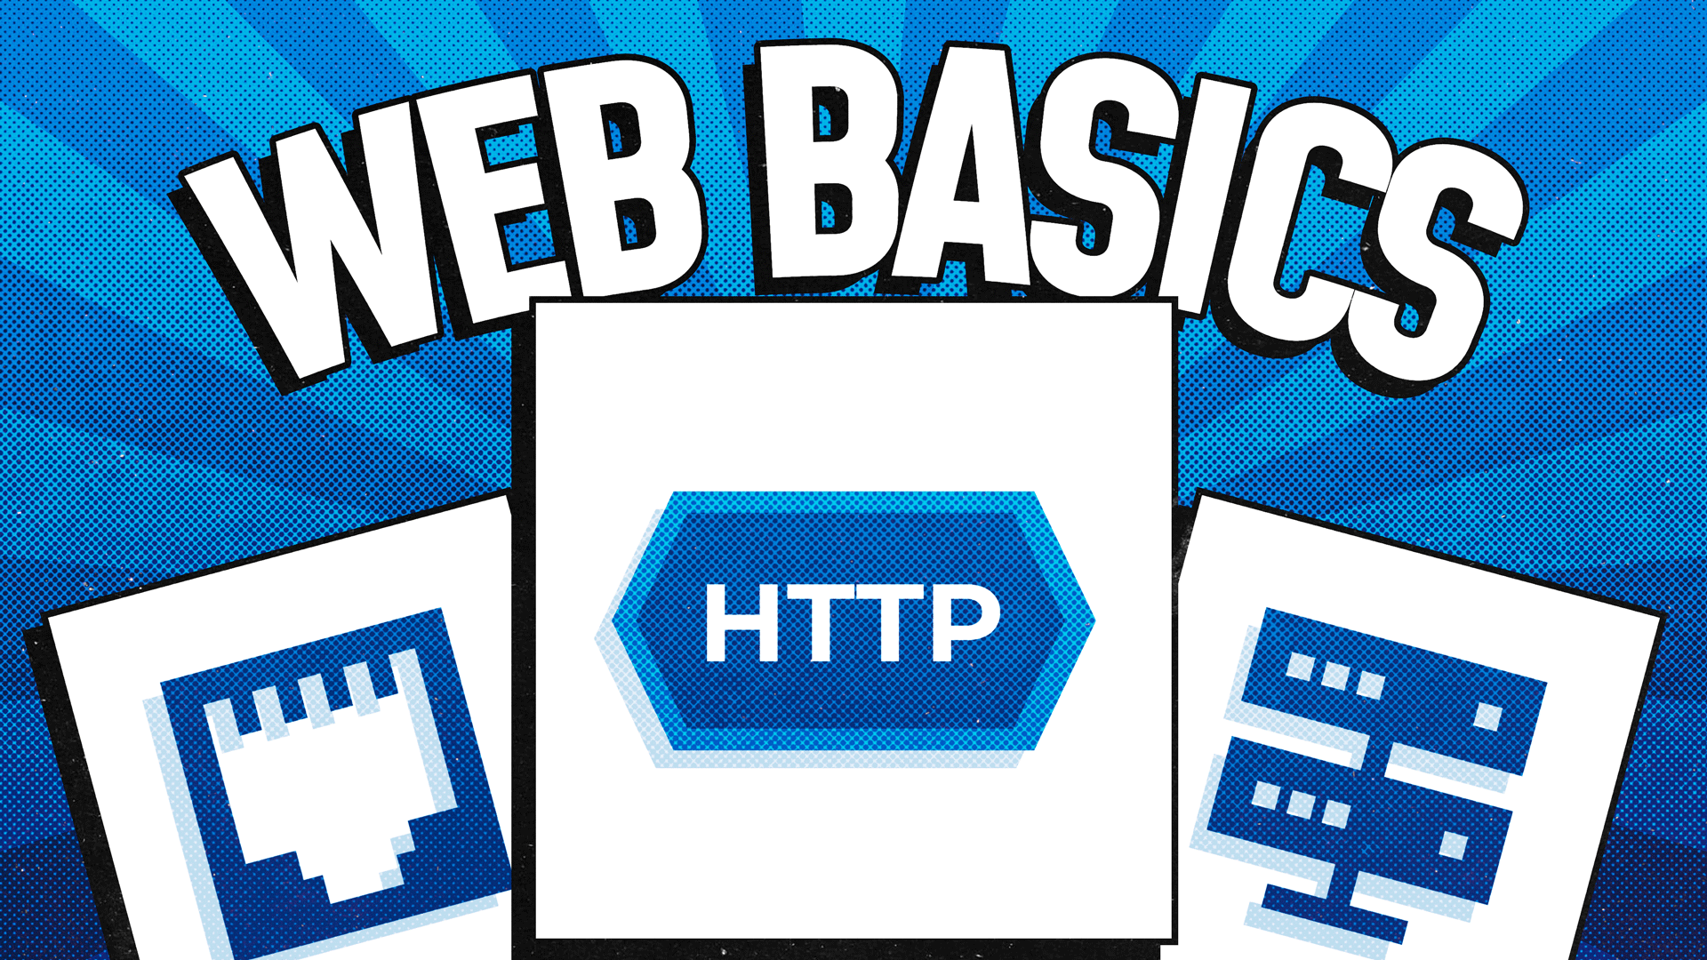

Slide 27
Сървър
Kомпютър, стартиращ сървърен софтуер предоставящ услуги като например хост (предлага информационни ресурси (HTML,снимки,текст и много други) за потребители в интернет);
Компютърна програма, която стартира като услуга, която обслужва заявки на други програми („клиенти“). Той слуша за заявки (request) и връща отговор (response), като и двете операции са по предварително зададен протокол;
Завършена софтуерна система например сървър база данни, файлов сървър, mail сървър;

Slide 28
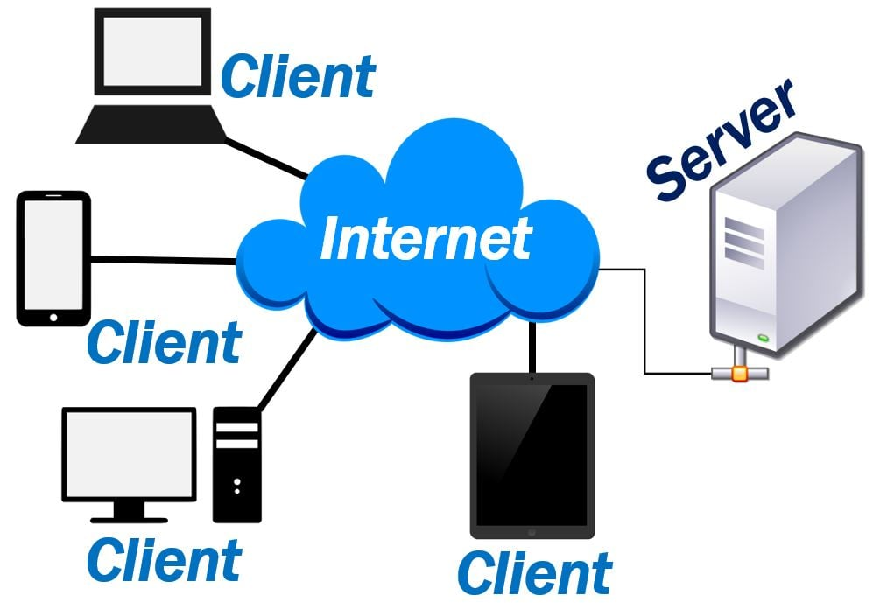

Slide 29
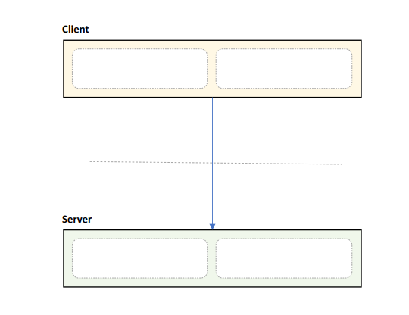
Client/Server Pattern – Layered
Distinct client and server
Separated by network
Communication protocol
Many clients, one server
Pros:
Secure & Simple
Centralized Control
Easy to manage
Cons:
Requires network, difficult to scale
Single point of failure
29

Slide 30
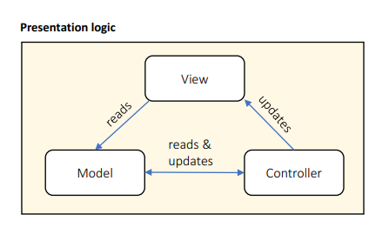
MVC Pattern
Designed for presentation layers
View handles output
Model handles data
Controller handles interaction
Pros:
Strict separation of concerns
Scales well
Cons:
High overhead
Scattered code
Hard to data-bind
30

Slide 31
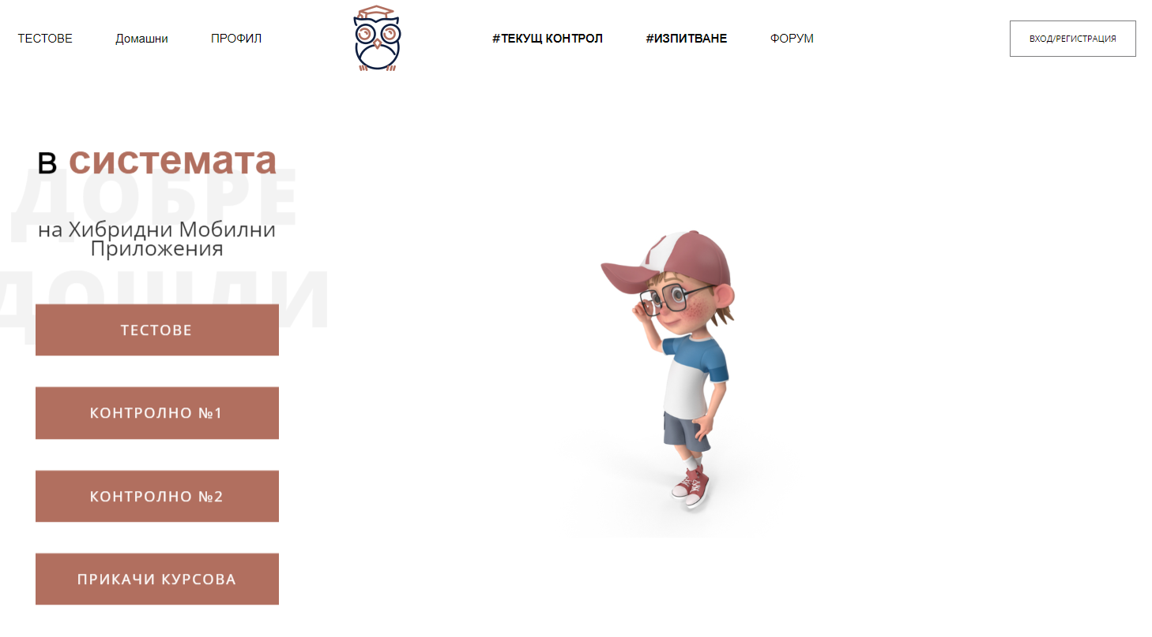
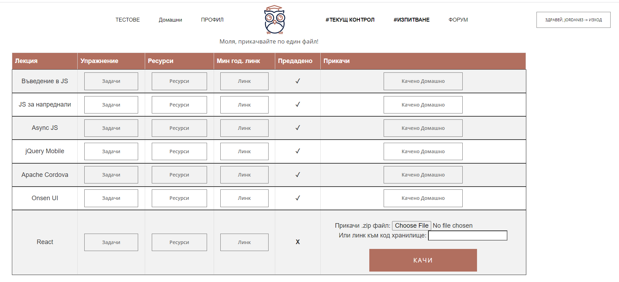
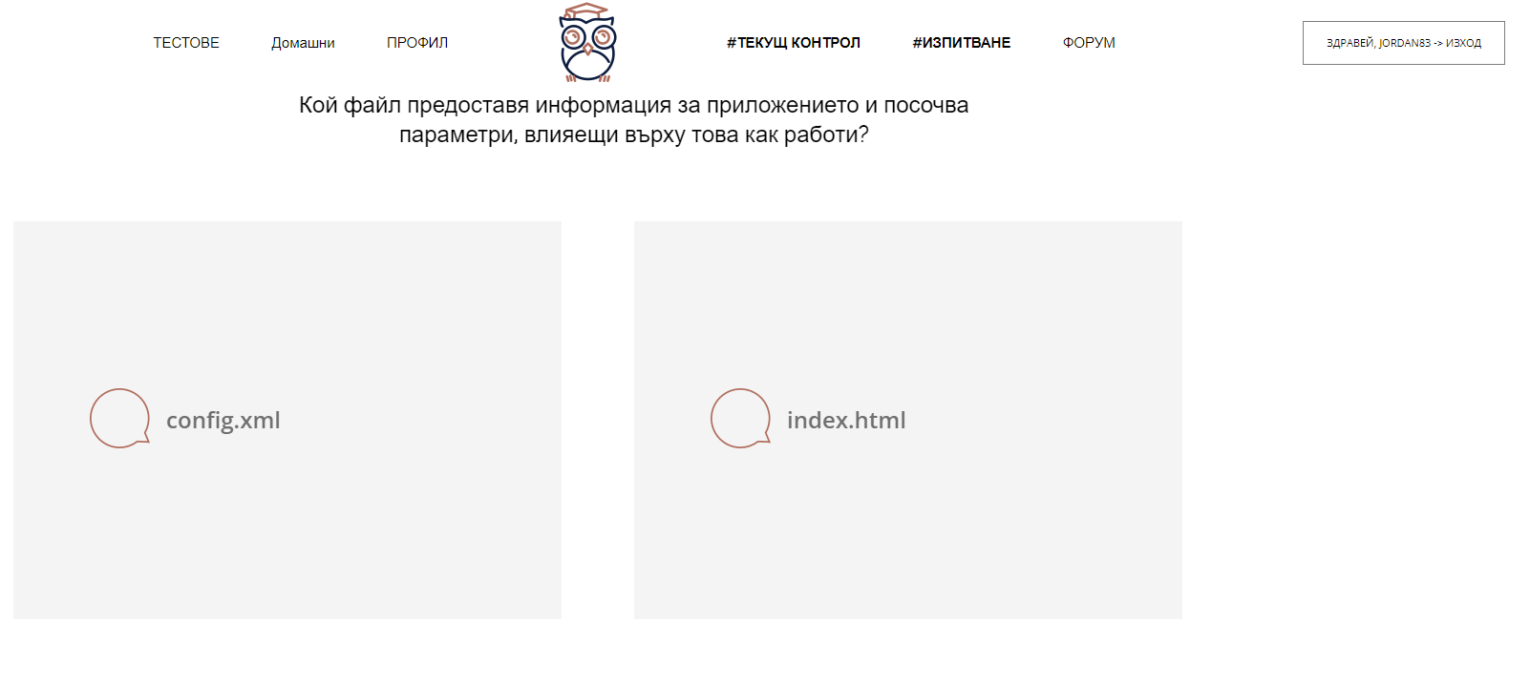


Students manager
Клиент е браузърът на текущия потребител
Уеб приложение, хостнато на уеб сървър
www.manager.com
HTML, CSS, JS, Pictures…
www.manager.com/Tests
HTML, CSS, JS, Pictures…

Slide 32
Single-Page Application
Взаимодейства с потребителя чрез динамично пренаписване на текущата уеб страница с нови данни от уеб сървъра, вместо да пре-зарежда цели нови страници. Целта е по-бързи преходи.
Клиент е отделно приложение, изпълняващо в браузъра на текущия потребител
Уеб приложение, хостнато на уеб сървър
www.manager.com
HTML, CSS, JS, Pictures…
www.manager.com/Tests
JSON
www.manager.com/bot
JSON

Slide 33
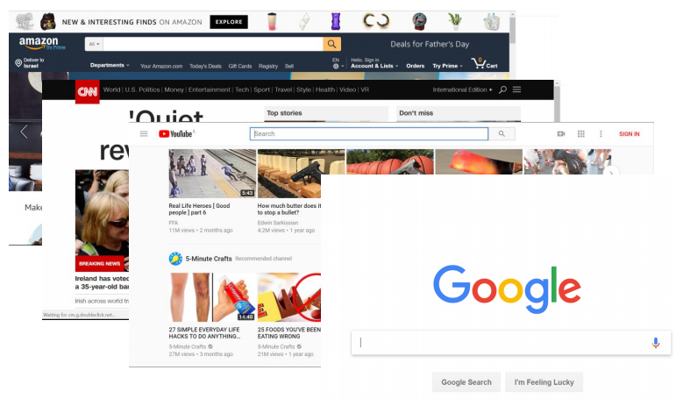
Application Types – Web application
Best suited for:
User interface
User initiated actions
Large scale
Short, focused actions
Request-Response based

Slide 34
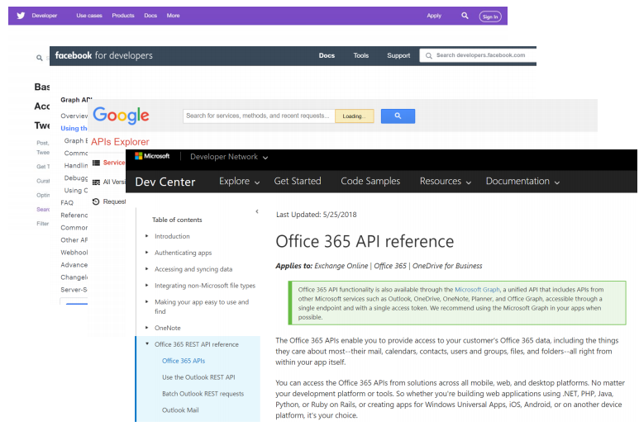
Application Types – Web API
Best suited for:
Data retrieval and storage
Client initiated actions
Large scale
Short, focused actions
Usually REST based
Returns data, not HTML
Combination of:
URL (https://www.mysite.com/api/orders)
Parameters (date=10/10/2017)
HTTP Verb (GET)

Slide 35
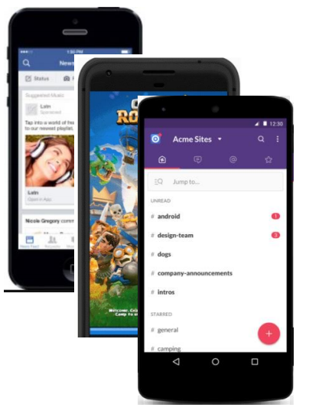
Application Types – Mobile Application
Best suited for:
Well, mobile devices ☺
User interaction (games, social apps)
Front end for Web API
Location & camera-based systems
Usually work with a Web API

Slide 36
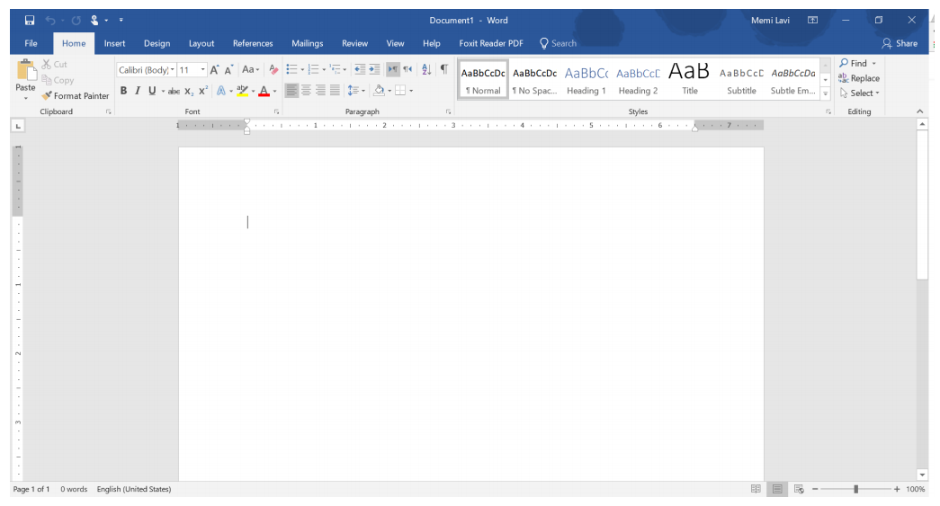
Application Types – desktop Application
Best suited for:
User centric actions
Gaming
Has all its resources on the local PC
Might connect to the web
Great UI

Slide 37
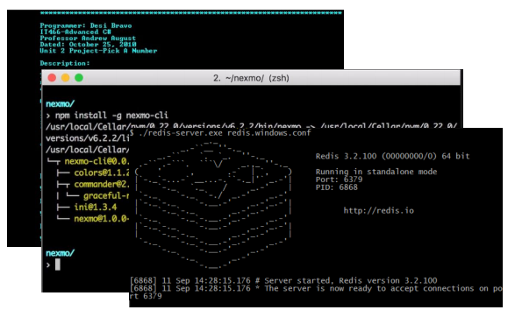
Application Types – Console Application
Best suited for:
Long-running processes
Short actions by trained power-users
No fancy UI
Require technical knowledge
Limited interaction
Long or short-running Processes

Slide 38
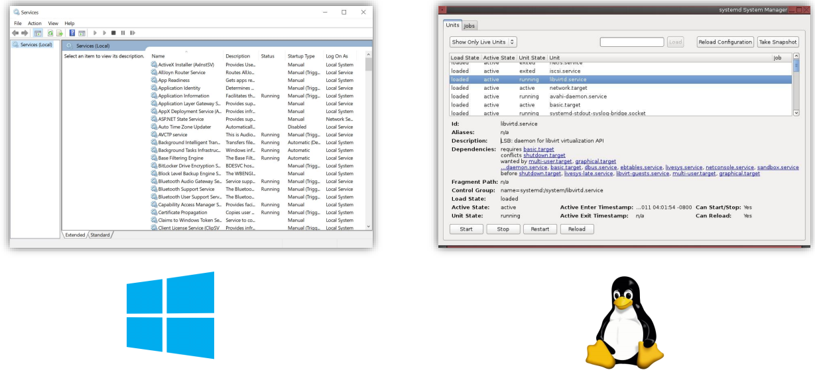
Application Types – Service
Best suited for:
Long-running processes
No UI at all
Managed by the OS service manager

Slide 39
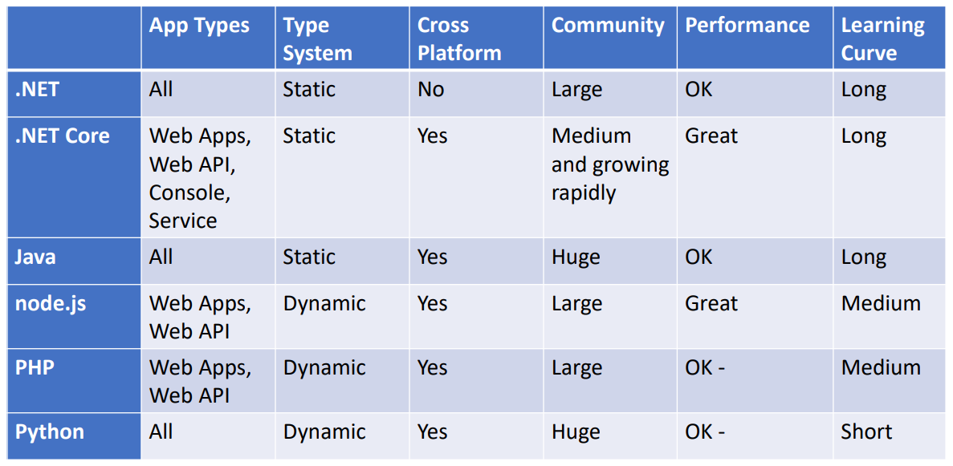
Back-end and service Technologies

Slide 40
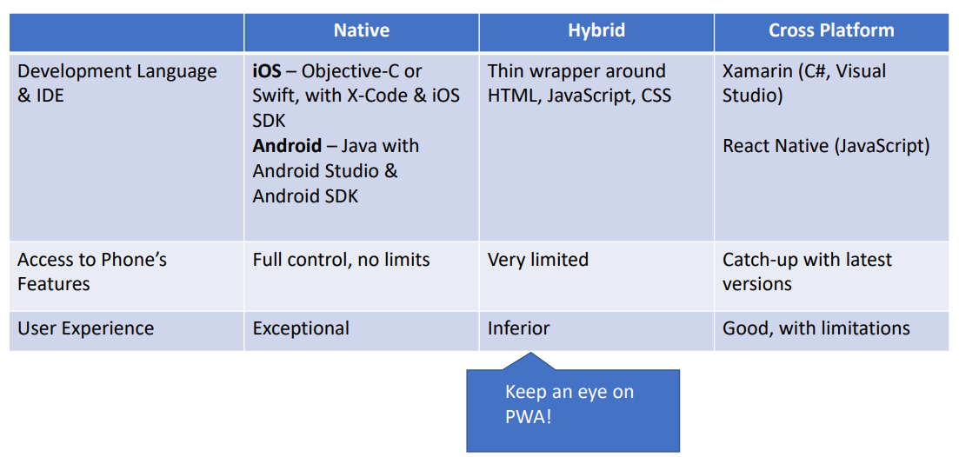
Mobile technologies

Slide 41
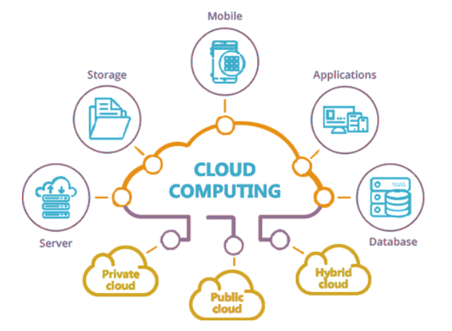

Slide 42

Технологиите, базирани на облак, дават възможност на организациите да създават и изпълняват приложения в модерни, динамични среди като публични, частни и хибридни облаци, чрез мрежи от услуги и микроуслуги. Качества на системите са устойчивост, висока наличност и достъпност, мащабируемост и управляемост, които са от критично значение за много от бизнес единиците. Автоматизацията на тези процеси позволява на инженерите да правят промени, с голямо въздействие, но с минимални усилия

Slide 43
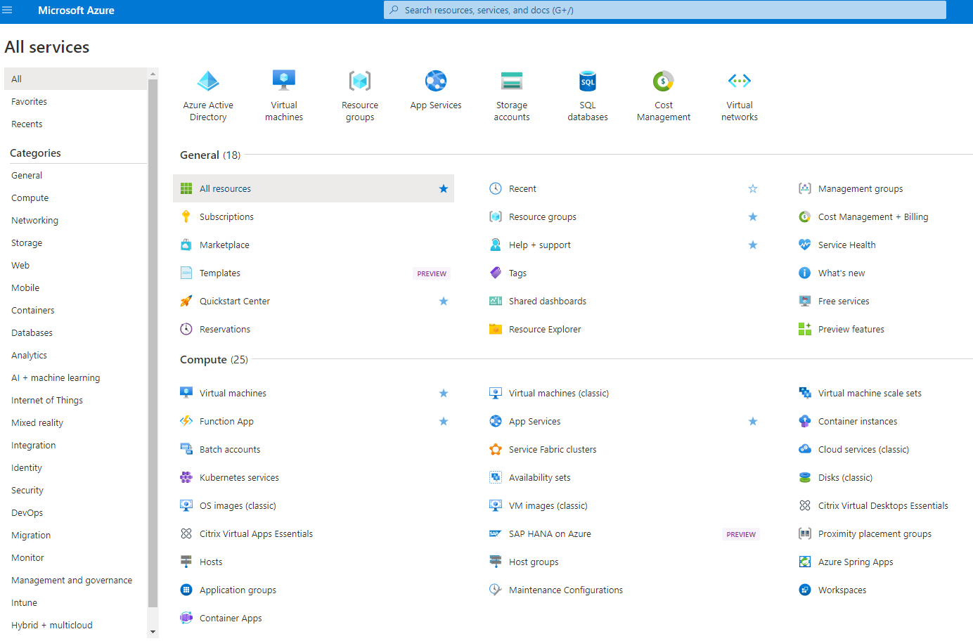

Slide 44


Slide 45
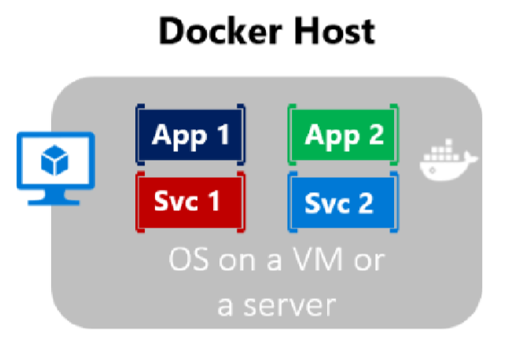
Containerization
Approach in which an application or service is packaged as an image
With its dependencies and configuration
The containerized application can be tested and deployed as a unit to the host OS
Allows deployments across environments with little or no modification
Containers also isolate applications from each other on a shared OS
The containers runs on a container host
The container host runs on an OS (Linux or Windows)
Thus having a smaller footprint than virtual machines

Slide 46
What is docker?
Docker is lightweight, open, secure
It simplifies building, shipping, and running applications
On different environments
Runs natively on Linux or Windows servers
Runs on Windows or Mac development machines
Relies on "images" and "containers"
The playground is a good starting point:
https://www.docker.com/play-with-docker

Slide 47
What is docker?
Image
An image is just like a blueprint
A read-only template
Contains the building blocks of an application
Framework, dependencies and code are "described" here
Container
Built from the image
It is the actual running environment for your application
Isolated and secured
It can be started, stopped, moved, and deleted
You create a container for your different application pieces
Database, Presentation, Caching, etc.

Slide 48
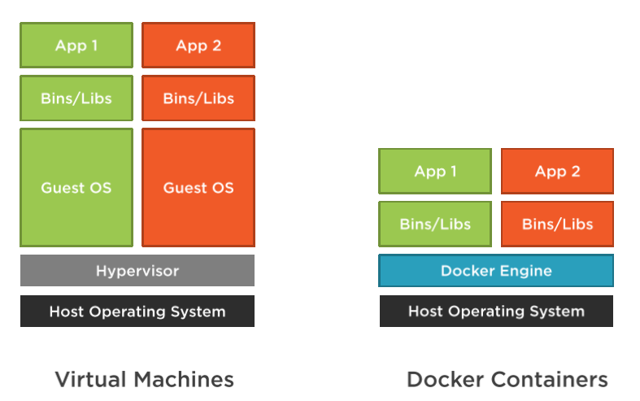
Docker VS Virtual Machines

Slide 49
Docker VS Virtual Machines
Virtual Machines
Have a guest OS, which is heavier
Images are bigger in terms of size
Slower startup time
Everything is a copy of the host OS
Docker
No guest OS, just a process
Images are small in terms of size
Fast startup time

Slide 50
Benefits for web developers
Accelerating developer onboarding
Eliminate application conflicts
Isolated containers
Environment consistency
If it runs on development environment, it should run on the staging/production
Ship software faster
Updating and migrating software is very easy

Slide 51
Docker Tools
Docker Desktop
Runs on Windows or Mac development machines
Includes Docker Engine, CLI and Kubernetes
Containerize and share any application
Complete Docker development environment
On Windows
Ability to switch between Linux and Windows Server environments
Supports Pro, Enterprise, and Education versions
For Home – you can only run Linux containers through WSL 2
There are third-party solutions for Linux – DockStation, CairoDock, and more…

Slide 52
Docker Tools
Docker Hub
Cloud-based application registry
Development team collaboration services
Supports public and private repositories
The world’s largest library of container images
Automated builds and webhooks
https://hub.docker.com/

Slide 53
DEMO

